Slide 1

Basics of YAML
NarendraP
StackStorm: Event-Driven Automation Tool for DevOps and Infrastructure

Slide 2
Basics of YAML
YAML stands for "Ain't Markup Language“
YAML is a human-readable data serialization language.
It is commonly used of configuration files and in applications where data is being stored or transmitted.
It is very simple and easy to pick up.
Learning the basics of this data serialization language will let you jump in and start working with a variety of tools, such as Ansible, Kubernetes, Salt, StackStorm etc.
YAML files are made up of three core components:
Scalars
Arrays/Lists
Mappings
StackStorm: Event-Driven Automation Tool for DevOps and Infrastructure

Slide 3
Components of YAML
We will discuss Components of YAML by comparing with Python data structures.
We have to start yaml files with - - - and by default each Yaml file is a dictionary in python.
Scalar of YAML is like a Simple variable in Python.
Example for scalar:
x: stackstorm
Note: Even a scalar is also a dictionary
We can store different type of data into scalar x.
They are like:
Numbers, Strings, Boolean and null data.
Example:
x: 2
y: 4.5
p: This is a string
q: “This also a sting \n”
Note: quotes are required when we have some special chars in a string
StackStorm: Event-Driven Automation Tool for DevOps and Infrastructure

Slide 4
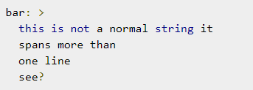
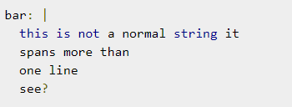
Components of YAML…
String values can span more than one line. With the fold (greater than) character, you can specify a string in a block.
Boolean data:
x: true
y: false
Null data:
x: null
Multiline String
StackStorm: Event-Driven Automation Tool for DevOps and Infrastructure

Slide 5

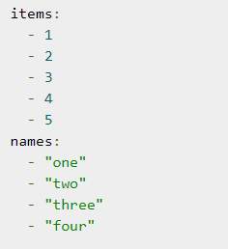
Components of YAML…
Arrays/Lists:
StackStorm: Event-Driven Automation Tool for DevOps and Infrastructure

Slide 6
Components of YAML…
Mappings or Dictionaries:
foo: { thing1: huey, thing2: louie, thing3: dewey }
foo:
thing1: huey
thing2: louie
thing3: dewey
StackStorm: Event-Driven Automation Tool for DevOps and Infrastructure

Slide 7
Combination of Lists and Dictionaries
StackStorm: Event-Driven Automation Tool for DevOps and Infrastructure

Slide 8
Thank you

